Slide 1






NIHONGO
Fun ＆ Easy
Unit1 Phrase1
さち
https://egg-nihongo-kyoshi.com
@egg_nihongo_kyoshi

Slide 2
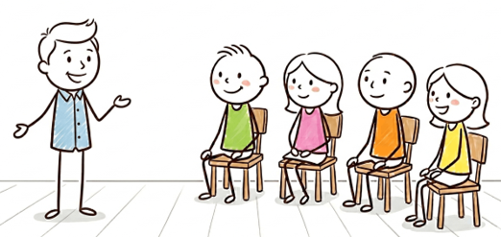
Unit 1 Phrase 1
Today’s Phrase
Watashi wa Jon desu.
I am John.
Noun wa Noun desu.

Slide 3
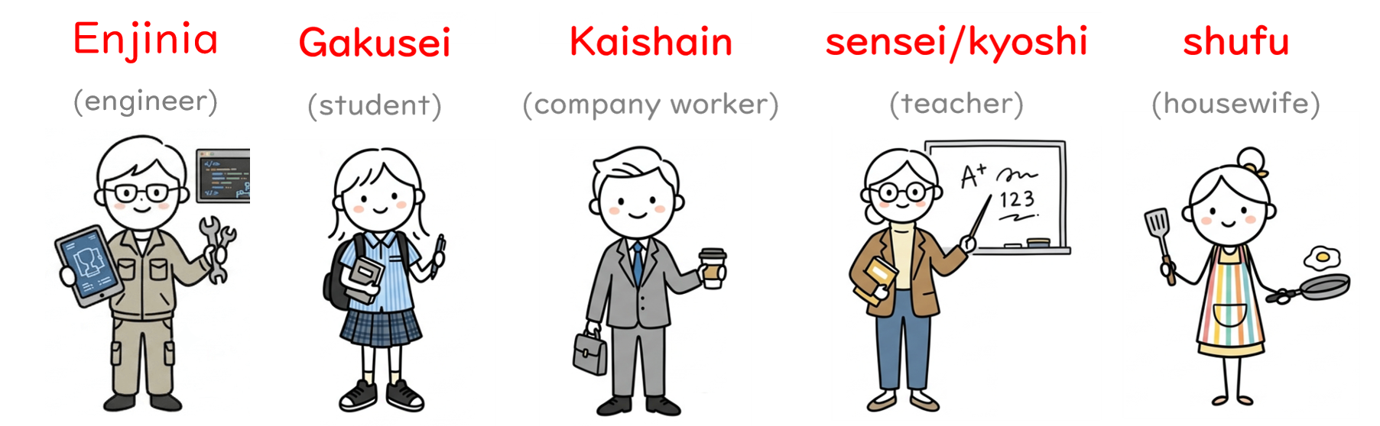
Unit 1 Phrase 1
Watashi wa ____ desu.
Jobs

Slide 4
engineer
エンジニア
enjinia

Slide 5
student
がくせい
gakusei

Slide 6
teacher
せんせい/きょうし
Sensei/kyōshi

Slide 7
company worker
かいしゃいん
kaishain

Slide 8
housewife
しゅふ
shufu

Slide 9
Japan
にほん
Nihon

Slide 10
India
インド
Indo

Slide 11
United Kingdom
イギリス
Igirisu

Slide 12
Australia
オーストラリア
Ōsutoraria

Slide 13

Unit 1 Phrase 1
Watashi wa ____ desu.
Jobs

Slide 14
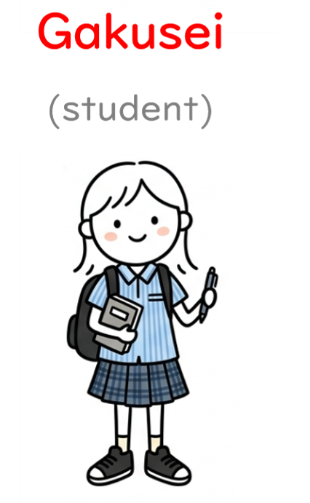
Unit 1 Phrase 1
Watashi wa ____ desu.
Jobs

Slide 15

Unit 1 Phrase 1
Watashi wa ____ desu.
Jobs

Slide 16
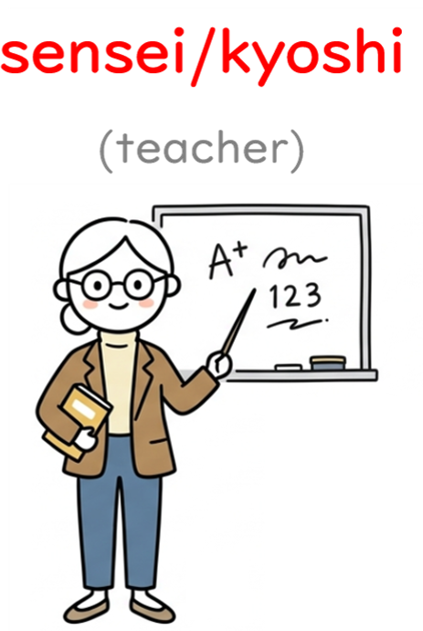
Unit 1 Phrase 1
Watashi wa ____ desu.
Jobs

Slide 17

Unit 1 Phrase 1
Watashi wa ____ desu.
Jobs

Slide 18

Unit 1 Phrase 1
Watashi wa ____ -jin desu.
Countries
Country people

Slide 19

Unit 1 Phrase 1
Watashi wa ____ -jin desu.
Countries

Slide 20
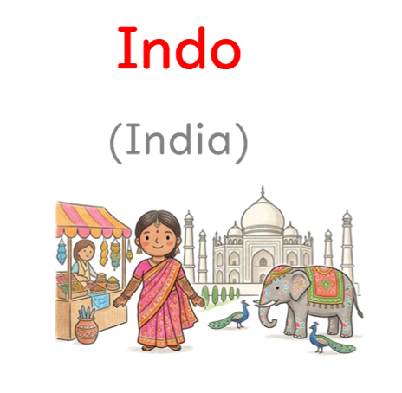
Unit 1 Phrase 1
Watashi wa ____ -jin desu.
Countries

Slide 21

Unit 1 Phrase 1
Watashi wa ____ -jin desu.
Countries

Slide 22

Unit 1 Phrase 1
Watashi wa ____ -jin desu.
Countries

Slide 23
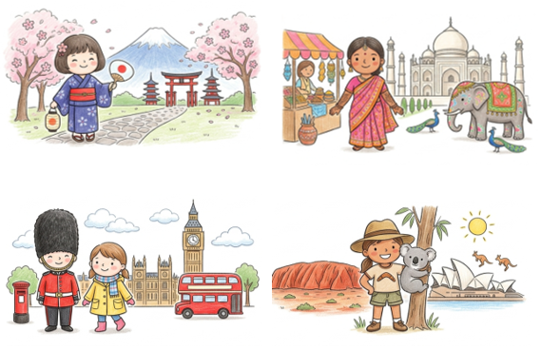

Unit 1 Phrase 1
Watashi wa (your name) desu.
(jobs) desu. (country people)-jin desu. Dozoyoroshiku.
Jobs
Countries

Slide 24

Unit 1 Phrase 1
A: B-san wa _____ desu ka.
B: （１）Hai, _____ desu.
（２） iie, _____ jya arimasen. _____ desu.
Jobs
Countries

Slide 25
Unit 1 Phrase 1
Today’s Phrase
Watashi wa Jon desu.
I am John.
Noun wa Noun desu.

